Slide 1
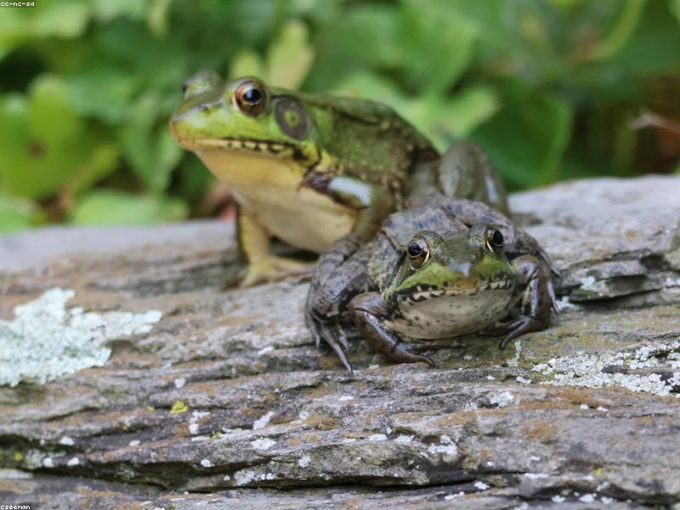
Introduction to Frogs
- Frogs are amphibians found on every continent except Antarctica.
- They belong to the order Anura, which means 'without a tail'.
- Frogs have a unique life cycle that includes both aquatic and terrestrial stages.

Slide 2
Anatomy of Frogs
- Frogs have long hind legs adapted for jumping.
- Their skin is permeable, allowing for respiration and hydration.
- Frogs possess bulging eyes that provide a wide field of vision.

Slide 3
Habitat and Distribution
- Frogs inhabit a variety of environments, including forests, wetlands, and grasslands.
- They are most commonly found in tropical regions.
- Frogs require water bodies for breeding and development.

Slide 4
Diet and Feeding
- Frogs are carnivorous, primarily feeding on insects and small invertebrates.
- Some larger species may consume small mammals or other frogs.
- Frogs use their long, sticky tongues to catch prey.

Slide 5
Conservation Status
- Many frog species are threatened due to habitat loss, pollution, and climate change.
- The chytrid fungus has caused significant declines in frog populations worldwide.
- Conservation efforts are underway to protect their habitats and species.

